Slide 1

Unit-5: Link Layer & Local Area Networks
Computer Networks (CN)
DU #2305CS332
Prof. Devangi L. Kotak
Department of Computer Application
Devangi.kotak@darshan.ac.in

Slide 2

Looping
Outline
Introduction to Link layer services
Error Detection and Correction Techniques
Multiple Access Protocols
Addressing
Ethernet, Switches & VLAN

Slide 3
Introduction of Data Link Layer

Slide 4
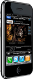
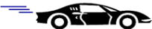
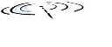

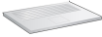


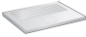





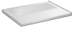
Introduction
Host and routers are as nodes.
Communication channels that connect adjacent nodes along communication path, its called links.
Wired links
Wireless links
LANs
In this layer, Packet is form of frame from encapsulate datagram.
This layer has responsibility of transferring datagram from one node to physically adjacent node over a link.
global ISP

Slide 5
Link Layer Services
Framing
Encapsulate datagram into frame.
Adding header and trailer.
Link Access
“MAC” addresses used in frame headers to identify source and destination. It is different from IP address.
Reliable Delivery
If this layer protocol provides reliable delivery service, it guarantees to move each network-layer datagram across the link without error.
A link-layer reliable delivery service can be achieved with acknowledgments and retransmissions.
Flow Control
Pacing between adjacent sending and receiving nodes.

Slide 6
Link Layer Services – Cont…
Error Detection & Correction
Errors caused by signal attenuation and noise.
Receiver detects presence of errors.
Sender send signal for retransmission or drops frame.
Receiver identifies and corrects bit error(s) without resorting to retransmission.

Slide 7
Error Detection & Correction Technique

Slide 8
Error Detection & Correction Technique
Techniques for error detection
Parity Check
Checksum Method
Cyclic Redundancy Check

Slide 9
Parity Check
One extra bit is sent along with the original bits to make number of 1s either even in case of even parity, or odd in case of odd parity.
For example, if even parity is used and number of 1s is even then one bit with value 0 is added. This way number of 1s remains even.
If the number of 1s is odd, to make it even a bit with value 1 is added.
1 | 0 | 0 | 1 | 0 | 0 | 1
1 | 0 | 0 | 1 | 0 | 0 | 1 | 1

Slide 10
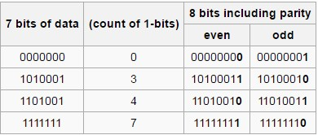
Parity Check – Cont…
Receiver counts the number of 1s in a frame. If the count of 1s is even and even parity is used, the frame is considered to be not-corrupted and is accepted.
If the count of 1s is odd and odd parity is used, the frame is still not corrupted.
If a single bit flips in transit, the receiver can detect it by counting the number of 1s.
But when more than one bits are erroneous, then it is very hard for the receiver to detect the error.

Slide 11
Checksum
Data is divided into k segments each of m bits.
Sender Side: Segments are added using 1’s complement arithmetic to get the sum.
Sum is complemented to get the checksum.
Checksum segment is sent along with the data segments.
Receiver Side: All received segments are added using 1’s complement arithmetic to get complemented sum.
If the result is zero, the received data is accepted; otherwise discarded.

Slide 12
Checksum - Example
Add two 16-bit integers word
Sender
Receiver
1 1 1 1 0 0 1 1 0 0 1 1 0 0 1 1 0
1 1 1 0 1 0 1 0 1 0 1 0 1 0 1 0 1
1 1 0 1 1 1 0 1 1 1 0 1 1 1 0 1 1
+
1 1 0 1 1 1 0 1 1 1 0 1 1 1 1 0 0
0 1 0 0 0 1 0 0 0 1 0 0 0 0 1 1
1 1 1 1 0 0 1 1 0 0 1 1 0 0 1 1 0
1 1 1 0 1 0 1 0 1 0 1 0 1 0 1 0 1
1 1 0 1 1 1 0 1 1 1 0 1 1 1 0 1 1
+
1 1 0 1 1 1 0 1 1 1 0 1 1 1 1 0 0
1 0 1 0 0 0 1 0 0 0 1 0 0 0 0 1 1
1 1 1 1 1 1 1 1 1 1 1 1 1 1 1 1
wraparound
sum
sum
checksum
If one of the bits is a 0, then we can
say that error introduced into packet
Note : when adding numbers, a carryout from the most significant bit needs to be added to the result

Slide 13
Cyclic Redundancy Check
CRC is the most powerful and easy to implement technique.
CRC is based on binary division.
In CRC, a sequence of redundant bits, are appended to the end of data unit so that the resulting data unit becomes exactly divisible by a second, predetermined binary number.
At the destination, the incoming data unit is divided by the same number.
If at this step there is no remainder, the data unit is assumed to be correct and is therefore accepted.
A remainder indicates that the data unit has been damaged in transit and therefore must be rejected.
The binary number, which is (r+1) bit in length, can also be considered as the coefficients of a polynomial, called Generator Polynomial.
x²+x¹+1 (polynomial equation) >> 1 1 1

Slide 14
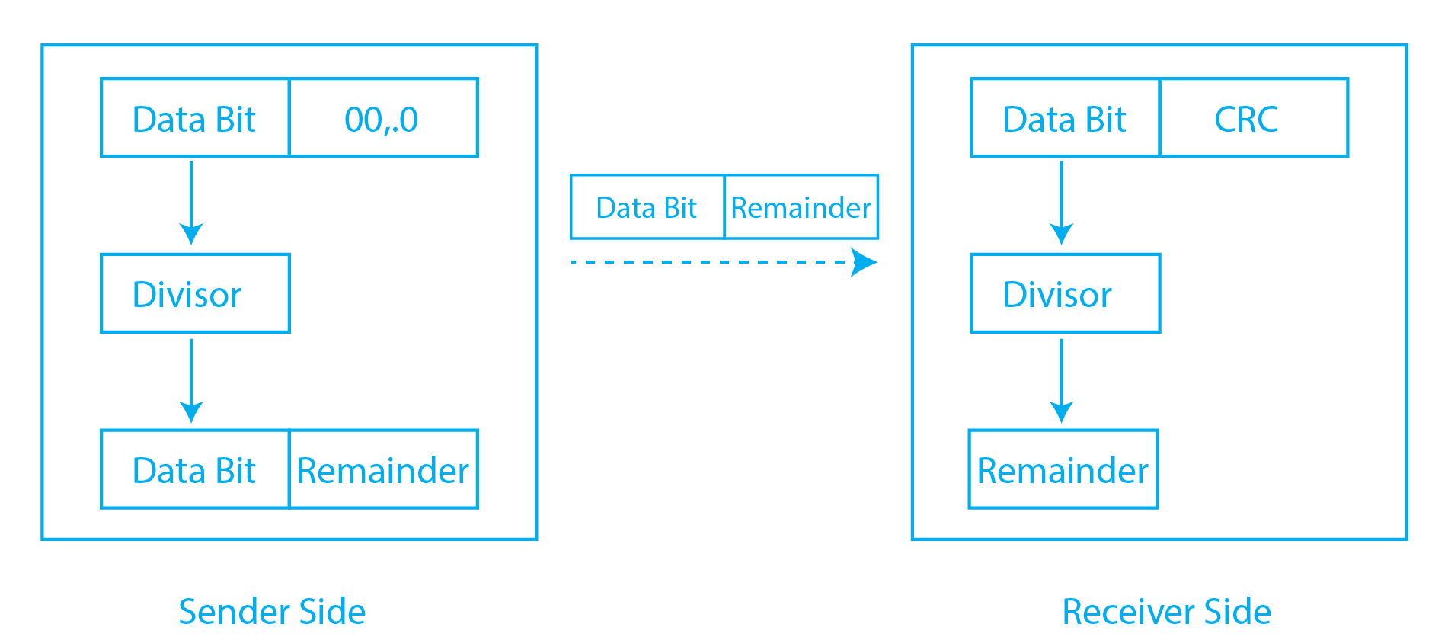
Working of CRC: Sender Side (CRC Generator and Modulo Division)
The first step is to add the no. of zeroes to the data to be sent, calculated using k-1 (k - is the bits obtained through the polynomial equation.)
Applying the Modulo Binary Division to the data bit by applying the XOR and obtaining the remainder from the division.
The last step is to append the remainder to the end of the data bit and share it with the receiver.

Slide 15
Working of CRC: Receiver Side (Checking for errors in the received data)
To check the error, perform the Modulo division again and check whether the remainder is 0 or not,
If the remainder is 0, the data bit received is correct, without any errors.
If the remainder is not 0, the data received is corrupted during transmission.

Slide 16
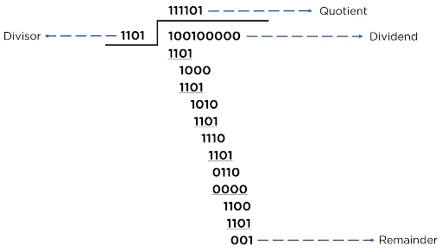
Example – Sender Side
The data bit to be sent is [100100], and the polynomial equation is [x³+x²+1].
Data bit - 100100
Divisor (k) - 1101 (Using the given polynomial)
Appending Zeros - (k-1) > (4-1) > 3
Dividend - 100100000

Slide 17
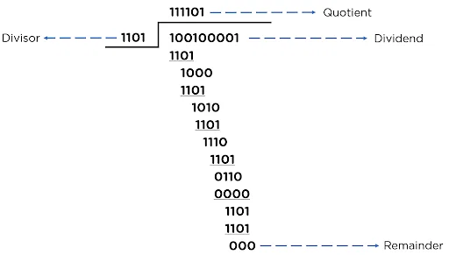
Receiver Side
New Data Bit - [100100001]
The Obtained remainder is [000], i.e., zero, which according to the CRC method, concludes that the data is error-free.

Slide 18
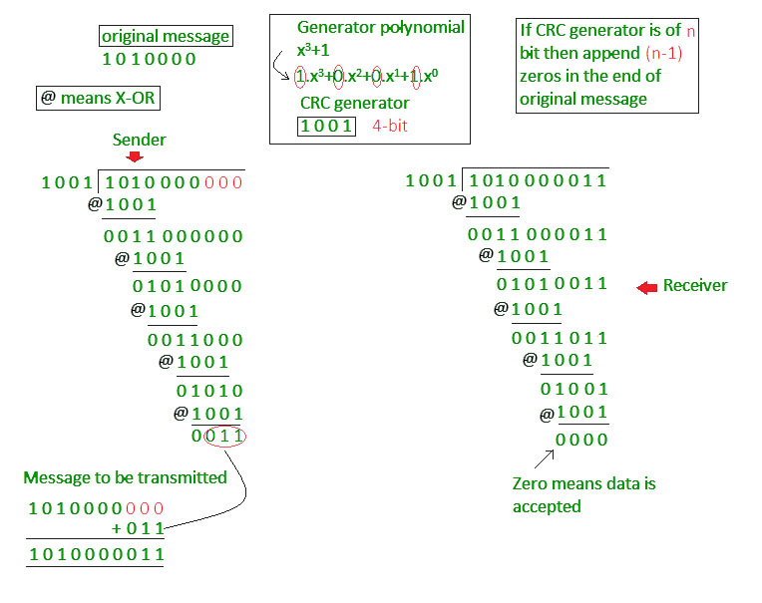
CRC – Example: 2

Slide 19
CRC – Example: 3

Slide 20
Multiple Access Links and Protocol

Slide 21
Multiple Access Links
There are two types of network links:
A point-to-point link consists of a single sender at one end of the link and a single receiver at the other end of the link.
A broadcast link, can have multiple sending and receiving nodes all connected to the same, single, shared broadcast channel.
The term broadcast is used here because when any one node transmits a frame, the channel broadcasts the frame and each of the other nodes receives a copy.

Slide 22
Multiple Access Protocols
Categories of Multiple Access Protocol:
Channel Partitioning Protocols
Divide channel into smaller “pieces” (time slots, frequency, code)
Allocate piece to node for exclusive use
Examples of channel partitioning protocols
TDMA: Time Division Multiple Access
FDMA: Frequency Division Multiple Access
CDMA: Code Division Multiple Access

Slide 23
Multiple Access Protocols – Cont…
Random Access Protocols
Channel is not divided and allow collisions.
“Recover” from collisions
Examples of random access MAC (Medium Access Control) protocols
Pure ALOHA
Slotted ALOHA
CSMA, CSMA/CD, CSMA/CA

Slide 24
Multiple Access Protocols – Cont…
Taking-turns protocols
Nodes take turns but nodes with more to send can take longer turns.
Examples of taking-turns protocols
Polling
Token passing

Slide 25
Channel Partitioning Protocols

Slide 26
TDMA: Time Division Multiple Access
Suppose the channel supports N nodes and that the transmission rate of the channel is R bps.
TDM divides time into time frames and further divides each time frame into N time slots.
Each time slot is then assigned to one of the N nodes.
Example: 6-station LAN, 1,3,4 have packet, slots 2,5,6 idle
Major drawbacks: First, A node is limited to an average rate of R/N bps even when it is the only node with packets to send.
Second drawback is that a node must always wait for its turn in the transmission sequence again, even when it is the only node with a frame to send.
6-slot
frame
6-slot
frame
1
3
4
1
3
4

Slide 27
FDMA: Frequency Division Multiple Access
Channel spectrum divided into frequency bands.
Each station assigned fixed frequency band.
Unused transmission time in frequency bands go idle.
Example: 6-station LAN, 1,3,4 have packet, frequency bands 2,5,6 idle
time
frequency bands
FDM cable

Slide 28
CDMA: Code Division Multiple Access
CDMA assigns a different code to each node, While TDM and FDM assign time slots and frequencies respectively.
Each node then uses its unique code to encode the data bits it sends.
If the codes are chosen carefully, CDMA networks have the wonderful property that different nodes can transmit simultaneously.
Their respective receivers correctly receive a sender’s encoded data bits in spite of interfering transmissions by other nodes.
Example:
Used in military and widespread civilian use, particularly in cellular telephony.
Because CDMA’s use is so tightly tied to wireless channels.

Slide 29
Random Access Protocols

Slide 30
Pure Aloha Protocol
It allows users to transmit whenever they have data to be sent.
Senders wait to see if a collision occurred (after whole message has been sent).
If collision occurs, each station involved waits a random amount of time then tries again.
Systems in which multiple users share a common channel in a way that can lead to conflicts are widely known as contention systems.
Whenever two frames try to occupy the channel at the same time, there will be a collision and both will be garbled.
If the first bit of a new frame overlaps with just the last bit of a frame almost finished, both frames will be totally destroyed and both will have to be retransmitted later.

Slide 31
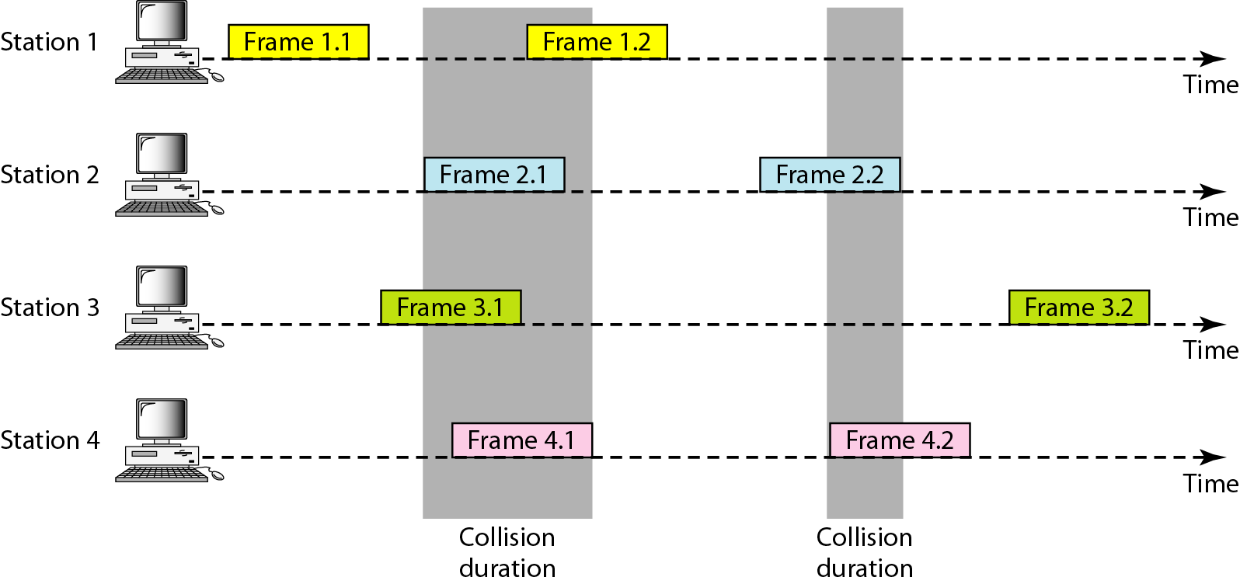
Pure ALOHA – Cont…
Frames are transmitted at completely arbitrary times.
The throughput of the Pure ALOHA is maximized when the frames are of uniform length.
The formula to calculate the throughput of the Pure ALOHA is
S-=G*e^{-2G}
The throughput is maximum when G=1/2 which is 18% of the total transmitted data frames.

Slide 32
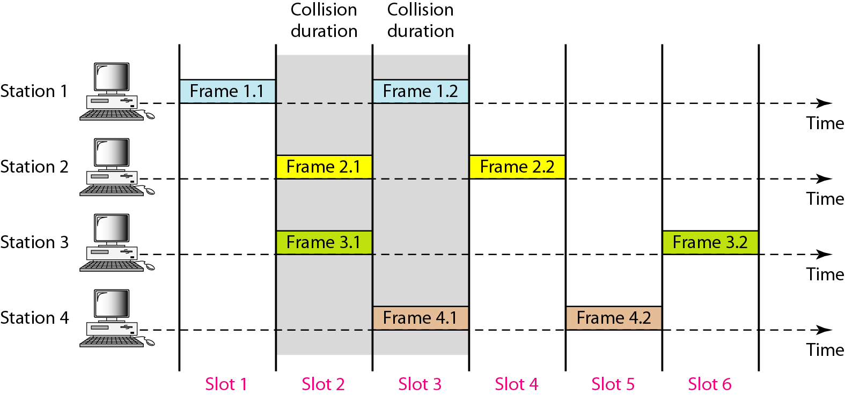
Slotted Aloha
It was invented to improve the efficiency of pure ALOHA as chances of collision in pure ALOHA are very high.
The time of the shared channel is divided into discrete intervals called slots.
The stations can send a frame only at the beginning of the slot and only one frame is sent in each slot.

Slide 33
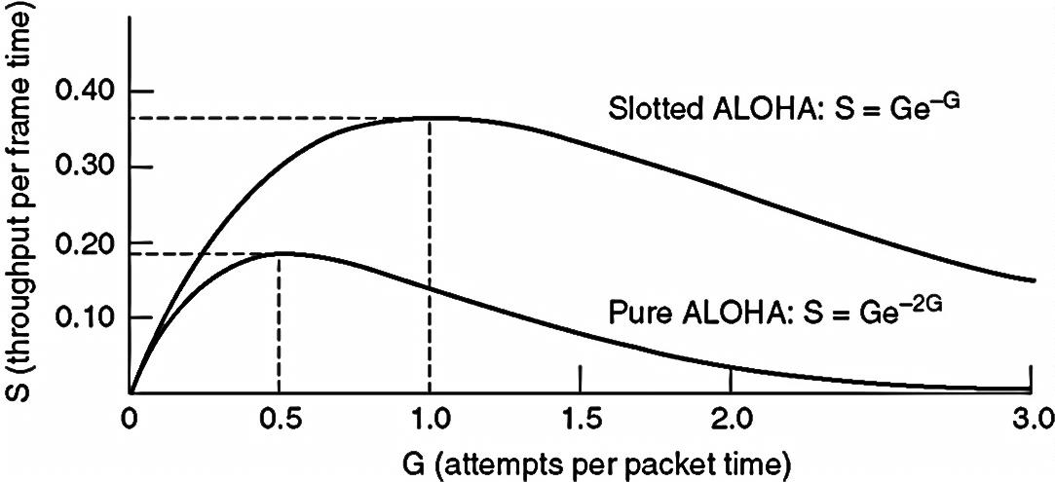
Slotted Aloha – Cont…
If any station is not able to place the frame onto the channel at the beginning of the slot then the station has to wait until the beginning of the next time slot.
The formula to calculate the throughput of the Slotted ALOHA is S=G*e^{-G}
The throughput is maximum when G=1 which is 37% of the total transmitted data frames.
37% of the time slot is empty, 37% successes and 26% collision.

Slide 34
CSMA/CD (CSMA with Collision Detection)
If two stations sense the channel to be idle and begin transmitting simultaneously, they will both detect the collision almost immediately.
Rather than finish transmitting, they should abruptly stop transmitting as soon as the collision is detected.
Quickly terminating damaged frames saves time and bandwidth.
This protocol, known as CSMA/CD (CSMA with Collision Detection) is widely used on LANs in the MAC sub layer.

Slide 35
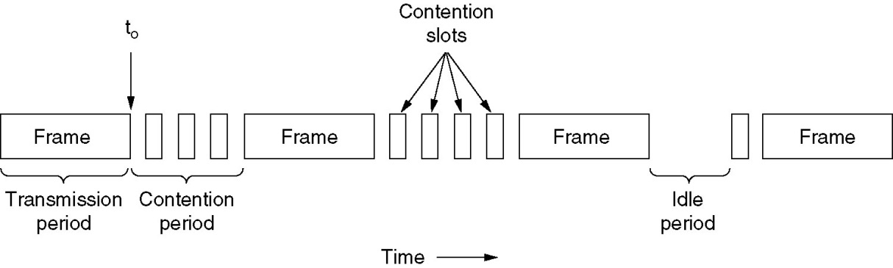
CSMA/CD – Cont…
At the point marked t₀, a station has finished transmitting its frame. Any other station having a frame to send may now attempt to do so.
After a station detects a collision, it aborts transmission, waits a random period of time, and then tries again, assuming that no other station has started transmitting in the meantime.
Therefore, CSMA/CD will consist of alternating contention and transmission periods, with idle periods occurring when all stations are quiet.

Slide 36
Taking-turns Protocols

Slide 37
Polling
It requires one of the nodes to be designated as a master node.
The master node polls each of the nodes in a round-robin fashion.
The master node first sends a message to node 1, saying that it (node 1) can transmit up to some maximum number of frames.
After node 1 transmits some frames, the master node tells node 2 it (node 2) can transmit up to the maximum number of frames.
The master node can determine when a node has finished sending its frames by observing the lack of a signal on the channel.

Slide 38
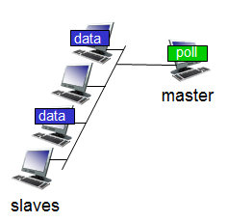
Polling – Cont…
The procedure continues in this manner, with the master node polling each of the nodes in a cyclic manner.
The polling protocol eliminates the collisions and empty slots that plague random access protocols.

Slide 39
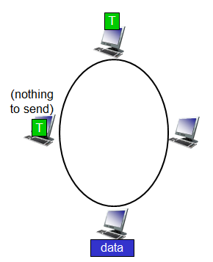
Token Passing
There is no master node.
A small, special-purpose frame known as a token is exchanged among the nodes in some fixed order.
For example, node 1 might always send the token to node 2, node 2 might always send the token to node 3, and node N might always send the token to node 1.
When a node receives a token, it holds onto the token only if it has some frames to transmit; otherwise, it immediately forwards the token to the next node.
If failure of one node can crash the entire channel. Or if a node accidentally neglects to release the token.

Slide 40
Ethernet
Ethernet is one of the widely used local area network (LAN) technology.
Switched Ethernet
It gives dedicated 10 Mbps bandwidth on each of its ports.
On each of the ports one can connect either a thick/thin segment or a computer.
Fast Ethernet
The 802.u or the fast Ethernet was approved by the IEEE 802 Committee.
It uses the same frame format, same CSMA/CD protocol and same interface as the 802.3, but uses a data transfer rate of 100 Mbps instead of 10 Mbps.
Fast Ethernet is based entirely on 10-Base-T.

Slide 41
Ethernet – Cont…
Gigabit Ethernet
Gigabit Ethernet is carried primarily on optical fiber (with very short distances possible on copper media).
Existing Ethernet LANs with 10 and 100 Mbps cards can feed into a Gigabit Ethernet backbone.
An alternative technology that competes with Gigabit Ethernet is ATM.
A newer standard, 10-Gigabit Ethernet is also becoming available.
E.g. 100-Base-T

Slide 42
Bit Stuffing & Byte stuffing

Slide 43
Bit Stuffing
In a bit-oriented protocol, the data to send is a series of bits.
In order to distinguish frames, most protocols use a bit pattern of 8-bit length (01111110) as flag at the beginning and end of each frame.
Here also cause the problem of appearance of flag in the data part to deal with this an extra bit added.
This method is called bit stuffing.
If a 0 and five successive 1 bits are encountered, an extra 0 is added.
The receiver node removes the extra-added zero.

Slide 44
Bit Stuffing - Example

Slide 45
Byte Stuffing
Problem of resynchronization by having each frame start and end with special bytes.
A flag byte is used to separate the frame as both the starting and ending delimiter.
This technique is called byte stuffing or character stuffing.
In this way, if the receiver ever loses synchronization, it can just search for the flag byte to find the end of the current frame.
Two consecutive flag bytes indicate the end of one frame and start of the next one.

Slide 46
Byte Stuffing - Example
To solve this problem, is to have the sender's data link layer insert a special escape byte (ESC) just before each "accidental" flag byte in the data.
The data link layer on the receiving end removes the escape byte before the data are given to the network layer.

Slide 47
ARP (Address Resolution Protocol)
It is a protocol for mapping an Internet Protocol address (IP address) to a physical machine address that is recognized in the local network.
For example, in IPv4 - an address is 32 bits long.
The physical machine address is also known as a Media Access Control or MAC address.
A table, usually called the ARP cache, is used to maintain a correlation between each MAC address and its corresponding IP address.
ARP provides the protocol rules for making this correlation and providing address conversion in both directions.

Slide 48
How ARP Works?

Slide 49
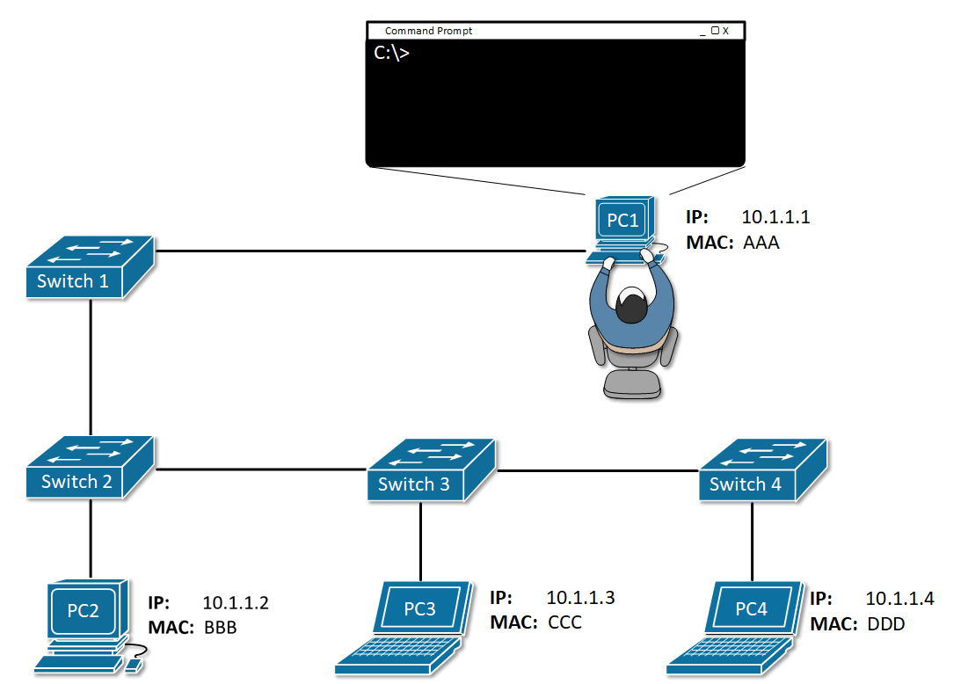

Slide 50
How ARP Works?
When an incoming packet arrives at a gateway, the gateway asks the ARP program to find a physical host or MAC address that matches the IP address.
The ARP program looks in the ARP cache and, if it finds the address, provides it so that the packet can be converted to the right packet length and format and sent to the machine.
If no entry is found for the IP address, ARP broadcasts a request packet in a special format to all the machines on the LAN to see if one machine knows that it has that IP address associated with it.
A machine that recognizes the IP address as its own returns a reply.
ARP updates the ARP cache for future reference and then sends the packet to the MAC address that replied.

Slide 51
Computer Networks (CN)
DU #2305CS332
Prof. Devangi L. Kotak
Department of Computer Application
Devangi.kotak@darshan.ac.in

